Slide 1
Citizens University Committee
Dr. Brian Haynes
Vice Chancellor for Student Affairs
April 27, 2022

Slide 2

Campus & Student Affairs Updates
Enrollment Update:
The University continues to grow:
Fall quarter enrollment 26,847 (+1.6% from 2020 and +27.8% from 2012)
22,866 UGRAD
3,981 GRAD
Spring Quarter:
The majority of classes have resumed to in-person instruction.
COVID-19 Update:
97% of the student body vaccinated
88% of the faculty and staff vaccinated
Combined 95.7%
Student Affairs Update:
Commencement 2022 will take place in-person on Pierce Lawn and in the Student Recreation Center from June 3-4 and June 10-13.
Academic Preparation Programs was awarded a grant of $4.8M as part of the Californians4All program; 150 students served; 450 community service hours; paid $10,000.
Chicano Student Programs and African Student Programs are poised to celebrate 50th anniversaries; those celebrations will take place later this year.

Slide 3
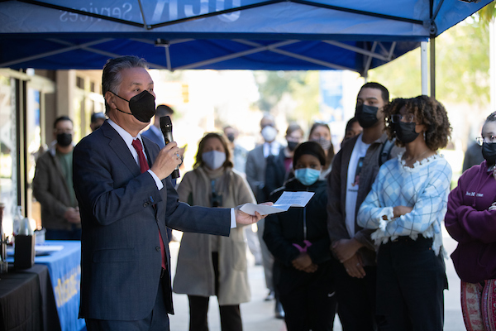
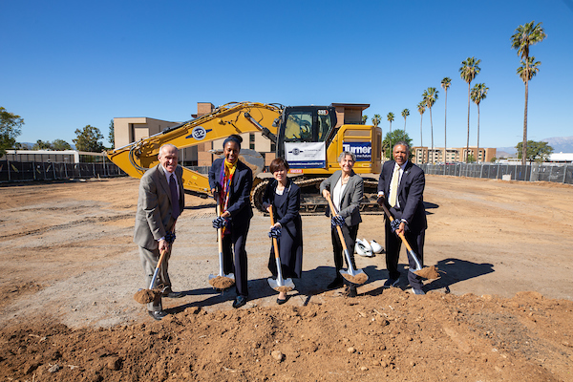
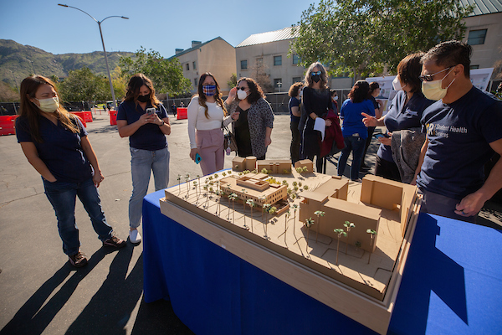
Campus Groundbreakings & Openings
Student Health Services & CAPS:
Groundbreaking ceremony took place on February 18, 2022.
New building to open May 2023.
Veterans’ Resource Center:
The campus celebrated the new center on February 24, 2022.
Representative Mark Takano addressed UCR’s veteran students.

Slide 4
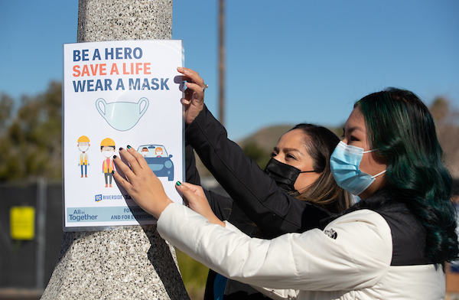
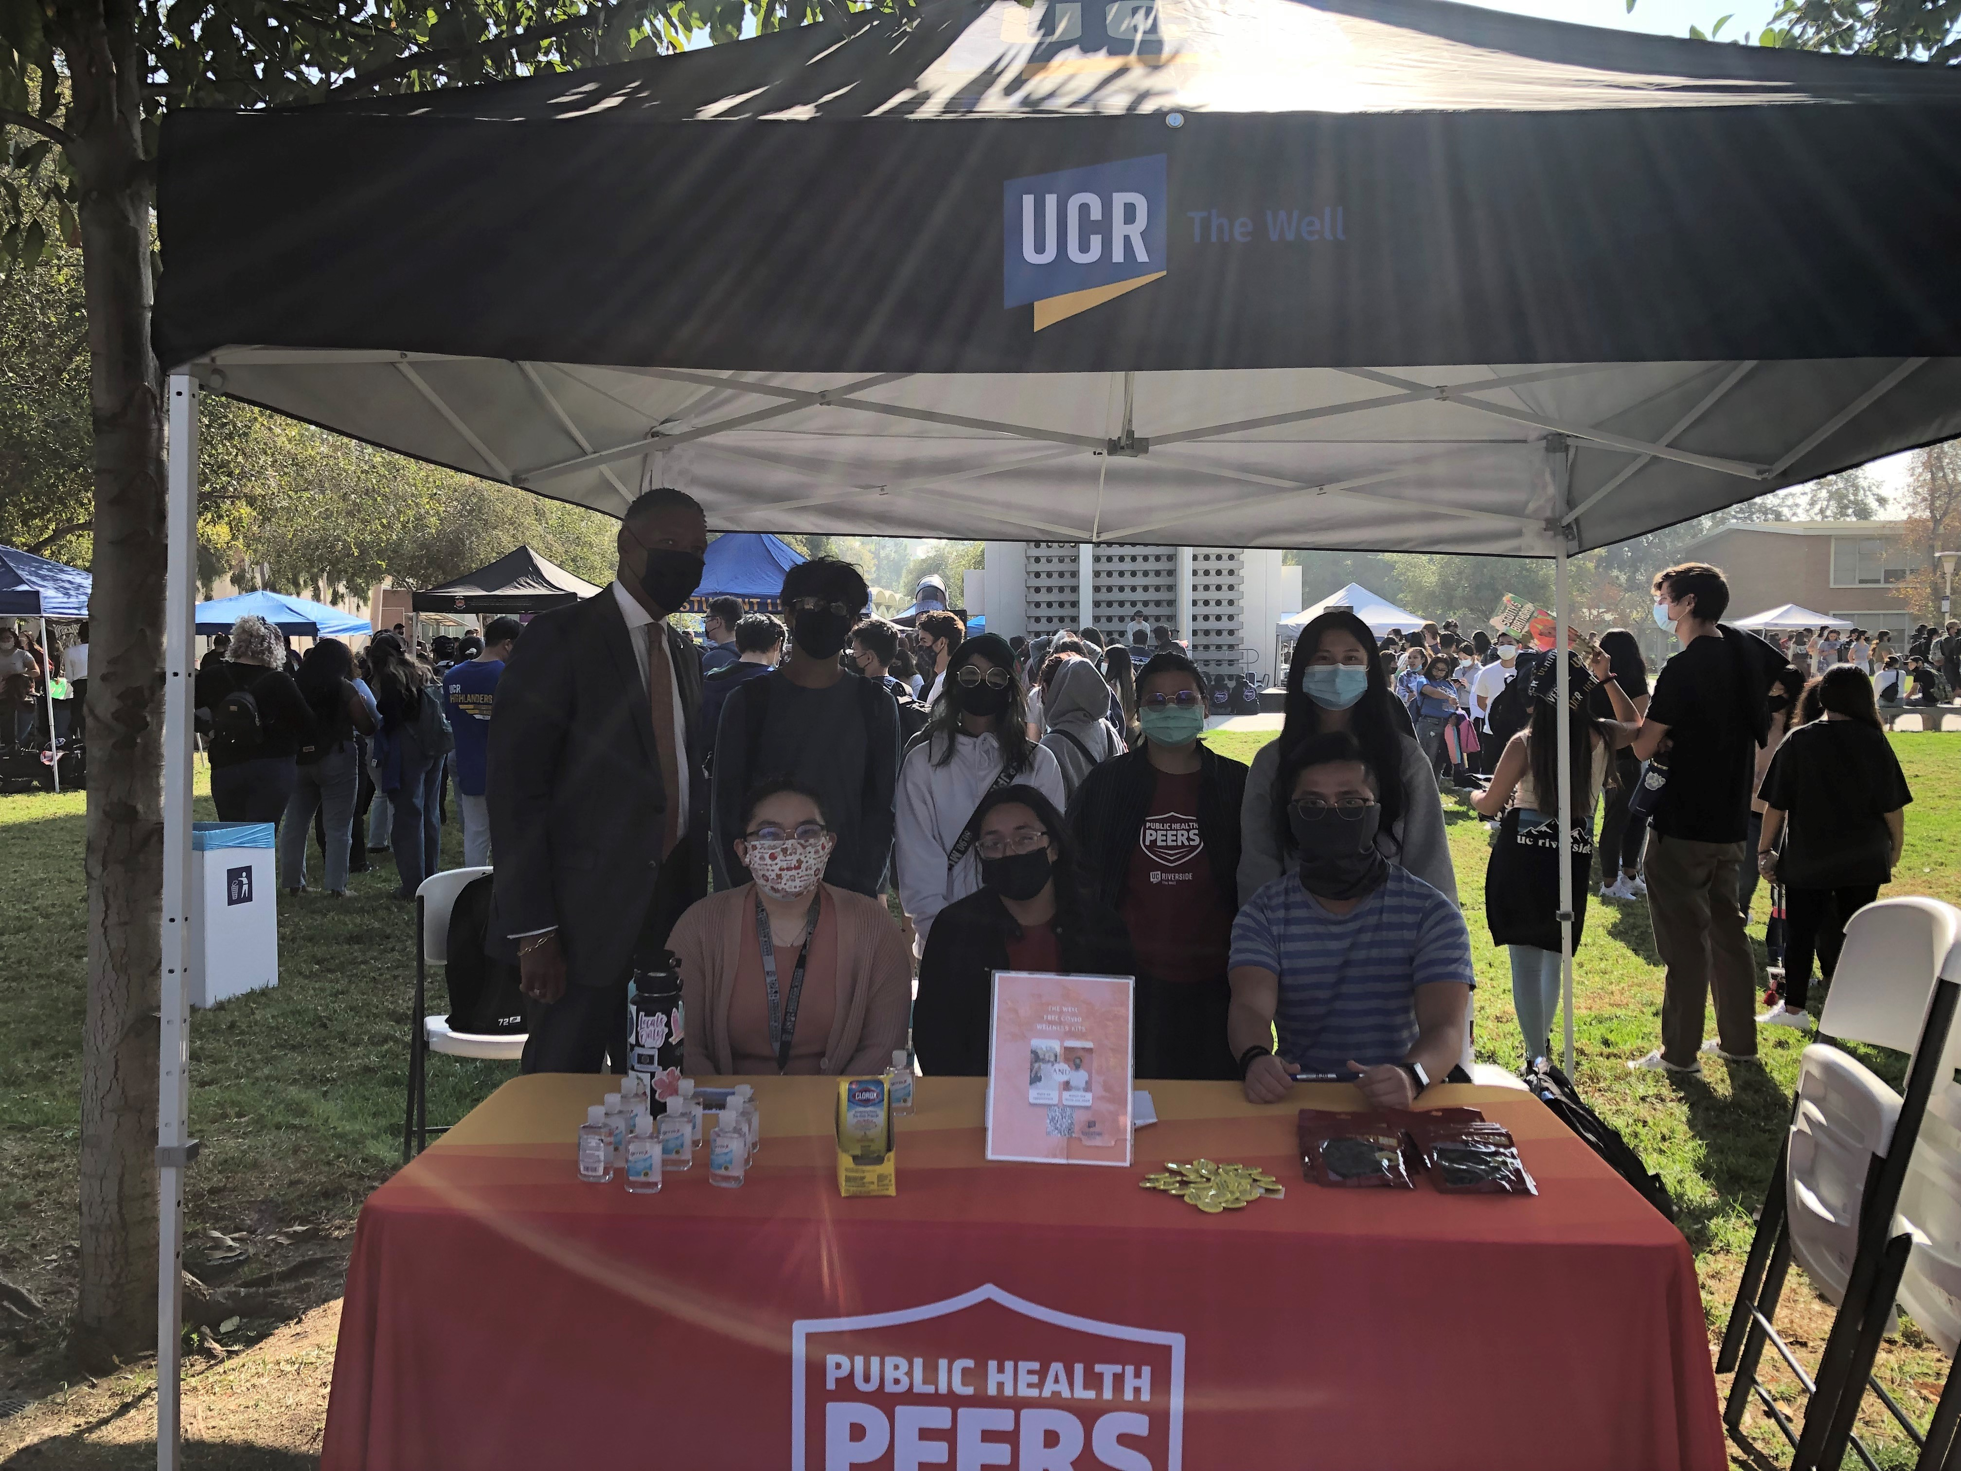
The Well’s Public Health Peers
1,225 COVID-19 Wellness Kits
1,351 Face Coverings
The Public Health Peers at the Well is a peer group dedicated to the education and prevention of COVID-19 and Flu among other public health topics.
The Public Health Peers manage programs such as the COVID-19 Wellness Kits, R'Safety PledgeCOVID-19 Bulk Supplies and the Personal Protective Equipment Stations across 13 departments across campus.

Slide 5
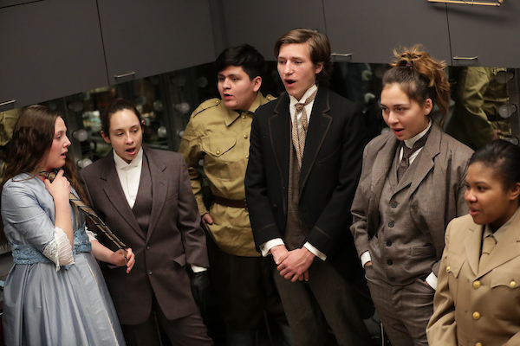
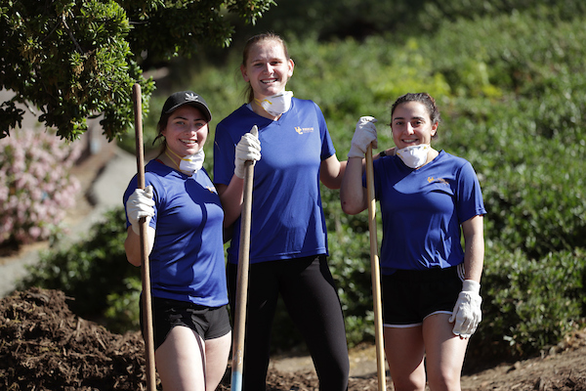
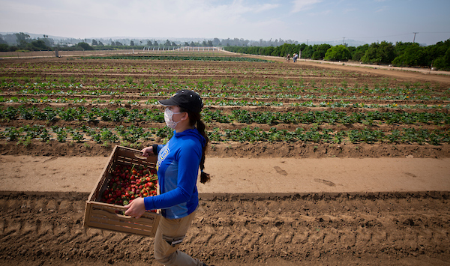
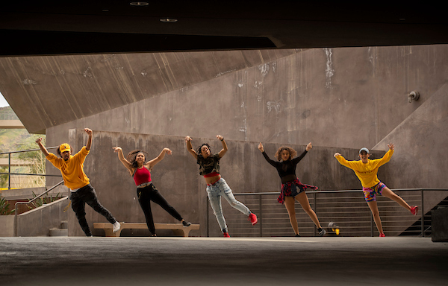
UCR Clubs & Organizations + Community Service
450 Clubs/Organizations on campus
In 2019, Washington Monthly ranked UCR the 16th best university in the nation for community service. UCR has been named to the Presidential Honor Roll for the impact our students have on their community.
Clubs:
Theatre: UCR Golden Mean Players
Theatre: R’shorts
Active Minds
R’Garden

Slide 6
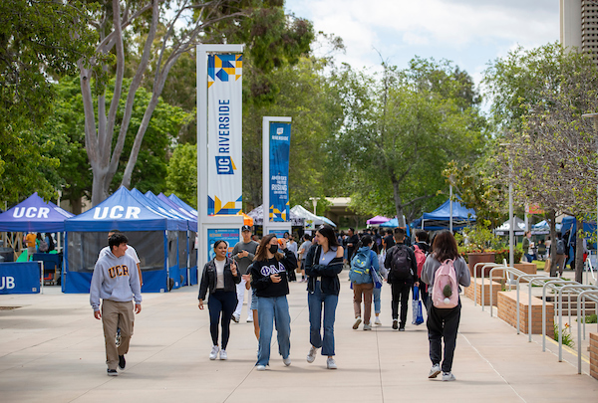
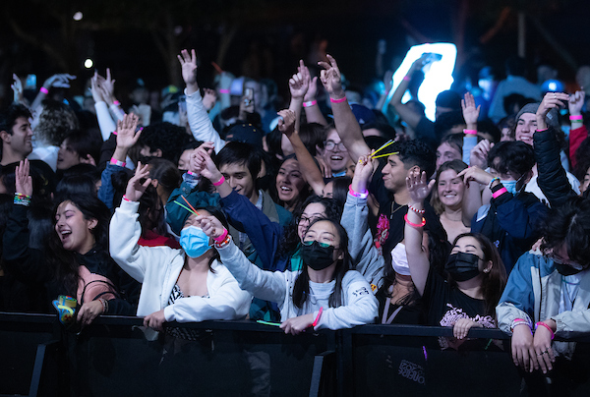
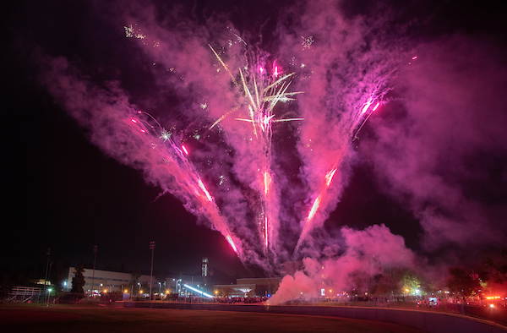
2021-2022 Student Events
Bonfire
Homecoming Weekend 2021
6,000 in attendance
Winter Soulstice:
March 4, 2022
2,000 students in attendance
Spring Splash:
May 14, 2022
Up to 10,000 students invited
Wednesday Nooners:
Music and food by the Bell Tower

Slide 7
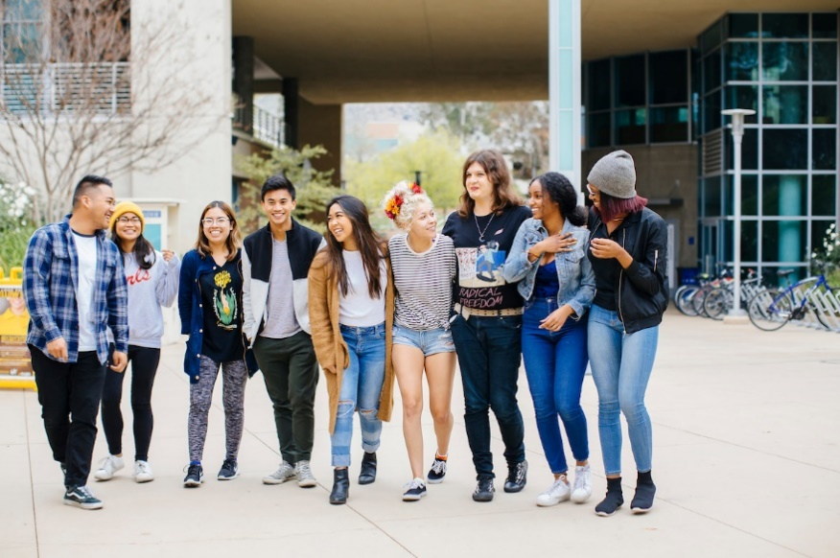
Division of Student Affairs
Vision Statement:
Student Affairs is committed to being a global leader in developing students through innovative, holistic, and transformative best practices to become change agents who inspire, motivate, and create a better world.
Mission Statement:
Student Affairs will provide a transformative experience for current and future world-class change agents through innovative and collaborative partnerships.

Slide 8
2025 Strategic Plan
Division of Student Affairs
Strategic Theme #1: Transform the Student Experience
The Division of Student Affairs will create a transformational experience that promotes students’ overall success, well-being, and resiliency at both the undergraduate and graduate levels.
Strategic Theme #2: Creating Collaborative Partnerships
The Division of Student Affairs will develop campus and community-based collaborative partnerships that foster a student-centered culture of engagement and success.
Strategic Theme #3: Establishing Organizational Excellence
Establish a strong organizational foundation for the division to recruit, hire, and retain a diverse and inclusive team of Student Affairs professionals who will actively contribute to student success.
Strategic Theme #4: Fostering and Advancing Social Justice
To effectively serve an increasingly diverse student body, the Division of Student Affairs will infuse diversity, inclusion, and social justice into every aspect of its work.

Slide 9
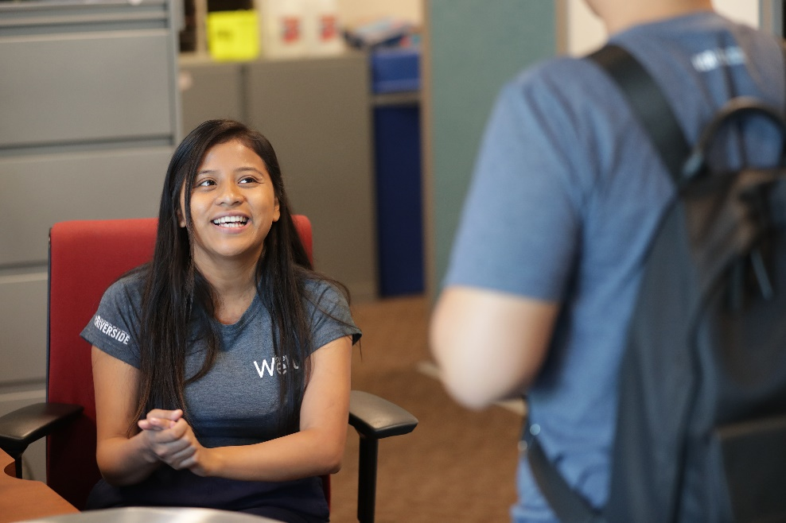
Health, Well-being & Safety
Basic Needs
Campus Advocacy, Resources & Education (CARE)
Counseling & Psychological Services (CAPS)
Student Affairs Case Management
Student Health Services
Student Disability Resource Center
The Well
UCPD

Slide 10
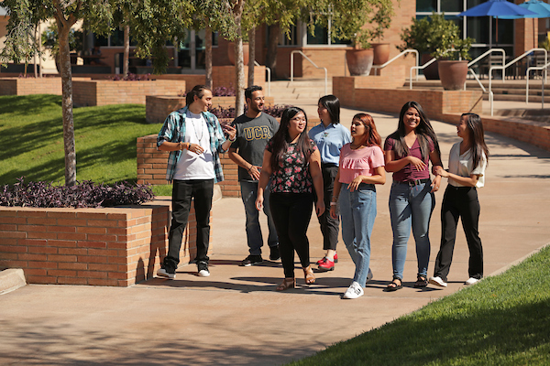
Campus Life
Academic Preparation Programs
Associated Students Program Board (ASPB)
Associated Students (ASUCR)
Athletics (Division I)
Career Center
Dean of Students
Graduate Students Association (GSA)
The Highlander Newspaper
Highlander Union Building (HUB)
KUCR
Residential Life
Student Conduct & Academic Integrity
Student Recreation Center
Student Veteran’s Resource Center

Slide 11
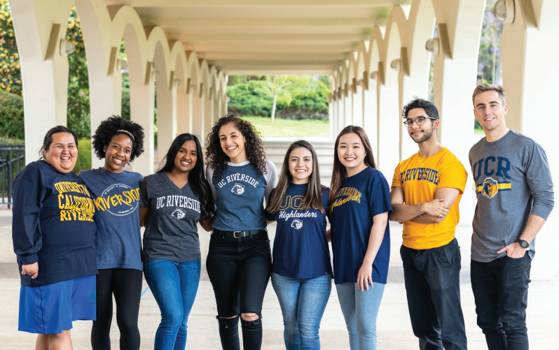
Ethnic & Gender Programs
African Student Programs (ASP)
Asian Pacific Student Programs (APSP)
Chicano Student Programs (CSP)
LGBT Resource Center
Middle Eastern Student Center (MESC)
Native American Student Programs (NASP)
The Office of Foster Youth Support Services
Undocumented Student Programs (USP)
Women’s Resource Center (WRC)

Slide 12
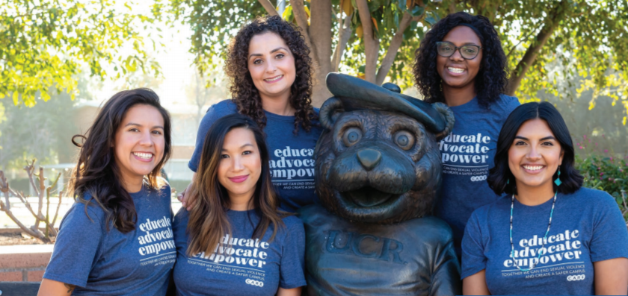
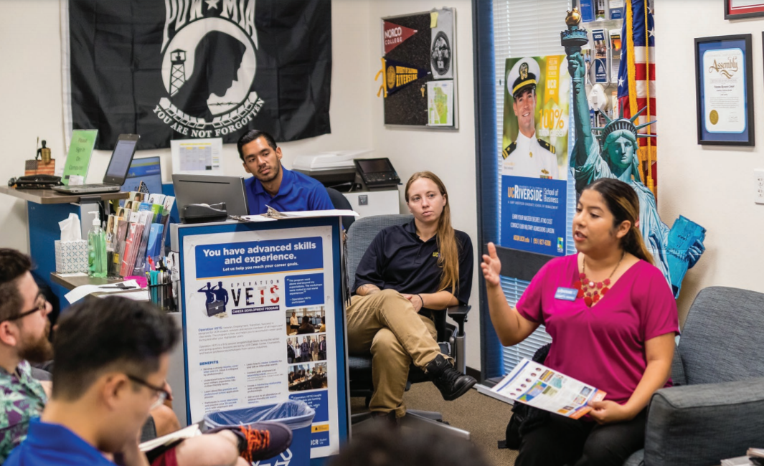
Most Promising Places to Work in Student Affairs 2021 & 2022
The Division of Student Affairs was named one of the top 15 most promising places to work in student affairs by Diverse: Issues in Higher Education and The American College Personnel Association (ACPA).

Slide 13
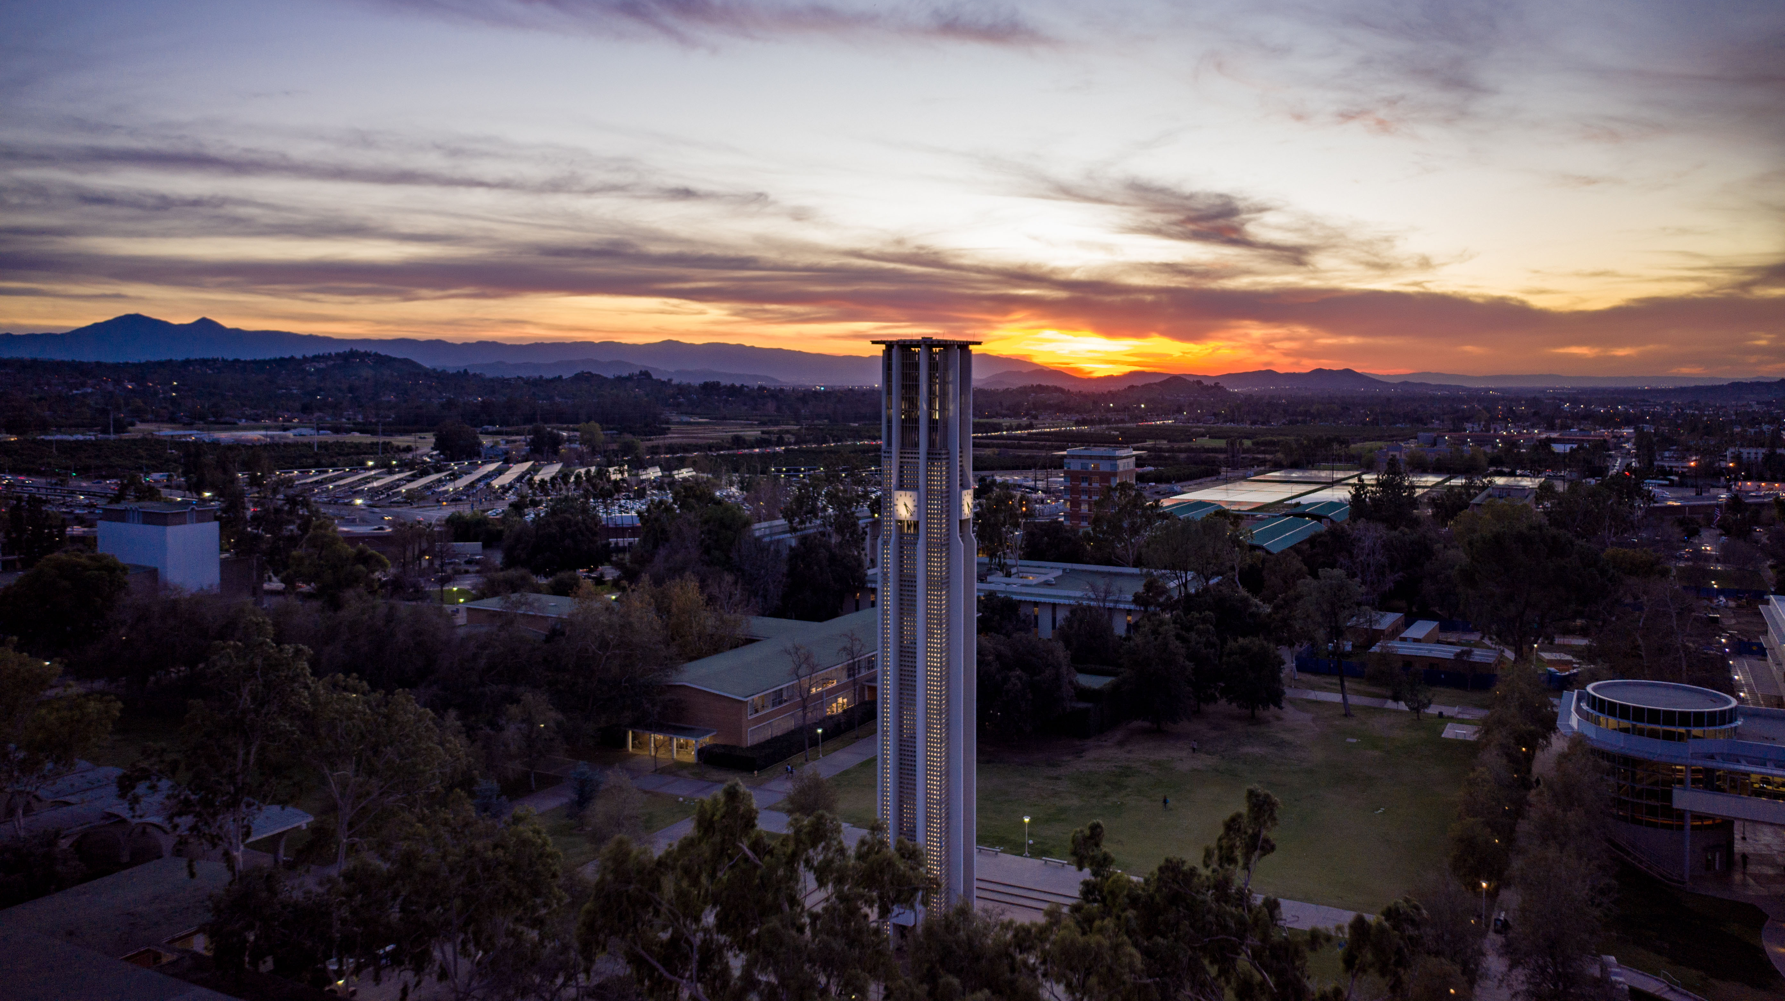
Email: vcsa@ucr.edu
Instagram: ucrstudentaffairs

