Slide 1
Campus Leadership:
Student Affairs Organization
Dr. Brian Haynes
Vice Chancellor for Student Affairs
March 28, 2022

Slide 2

The Student Affairs Organization
Who we are and what we do
What does that mean for the University?

Slide 3
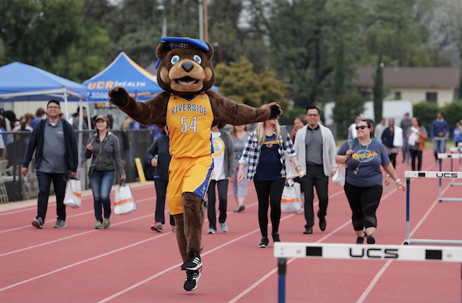
Team Building for the Better
Individual commitment to a group effort – that is what makes a team work, a company work, a society work, a civilization work.
Vince Lombardi
A Team Must Work Together
No one rises to low expectations.
Les Brown
Great things in business are never done by one person; they are done by a team of people.
Steve Jobs
Talent wins games, but teamwork and intelligence wins championships.
Michael Jordan

Slide 4
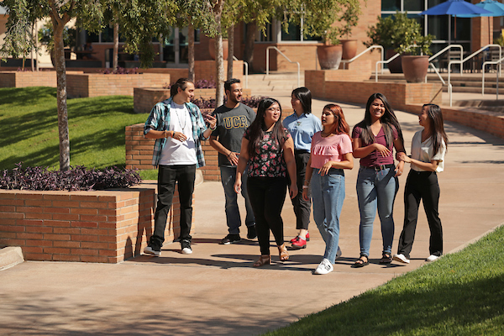
Student Engagement = Student Success
Academic Preparation Programs
Associated Students Program Board (ASPB)
Associated Students (ASUCR)
Athletics (Division I)
Career Center
Dean of Students
Graduate Students Association (GSA)
The Highlander Newspaper
Highlander Union Building (HUB)
KUCR
Residential Life
Student Conduct & Academic Integrity
Student Recreation Center
Student Veteran’s Resource Center

Slide 5
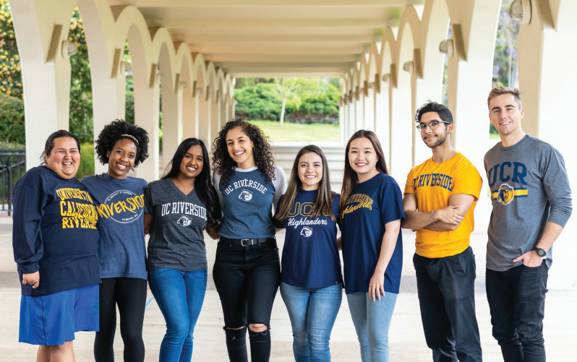
Ethnic & Gender Programs = Student Excellence
African Student Programs (ASP)
Asian Pacific Student Programs (APSP)
Chicano Student Programs (CSP)
LGBT Resource Center
Middle Eastern Student Center (MESC)
Native American Student Programs (NASP)
The Office of Foster Youth Support Services
Undocumented Student Programs (USP)
Women’s Resource Center (WRC)

Slide 6
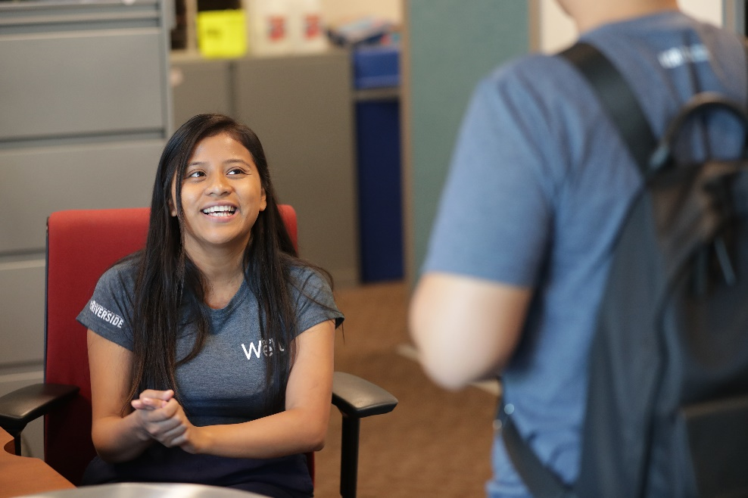
Health, Well-being & Safety = Student Transformation
Basic Needs
Campus Advocacy, Resources & Education (CARE)
Counseling & Psychological Services (CAPS)
Student Affairs Case Management
Student Health Services
Student Disability Resource Center
The Well
UCPD

Slide 7
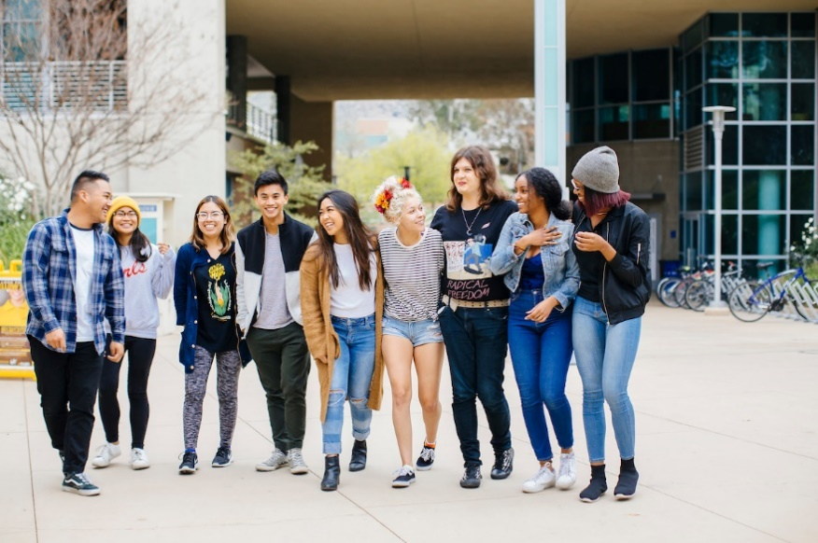
Developing the Foundation for Transformation
Vision Statement:
Student Affairs is committed to being a global leader in developing students through innovative, holistic, and transformative best practices to become change agents who inspire, motivate, and create a better world.
Mission Statement:
Student Affairs will provide a transformative experience for current and future world-class change agents through innovative and collaborative partnerships.

Slide 8
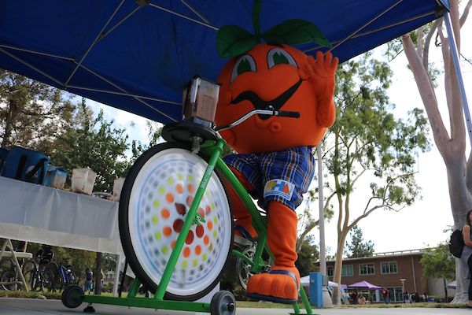
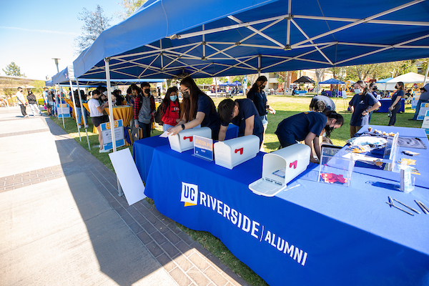
Opportunity for Campus Partnerships
Collaboration = Brilliance
Academic Affairs
  Academic Advising
City of Riverside
  High schools
  Elementary/Middle schools
College/School Senior Communicators
Enrollment Services
Healthy Campus
International Affairs
Office of Advancement
Student Peer Health Ambassadors
UCR Alumni Association
Undergraduate Education

Slide 9
2025 Strategic Plan
Division of Student Affairs
Strategic Theme #1: Transform the Student Experience
The Division of Student Affairs will create a transformational experience that promotes students’ overall success, well-being, and resiliency at both the undergraduate and graduate levels.
Strategic Theme #2: Creating Collaborative Partnerships
The Division of Student Affairs will develop campus and community-based collaborative partnerships that foster a student-centered culture of engagement and success.
Strategic Theme #3: Establishing Organizational Excellence
Establish a strong organizational foundation for the division to recruit, hire, and retain a diverse and inclusive team of Student Affairs professionals who will actively contribute to student success.
Strategic Theme #4: Fostering and Advancing Social Justice
To effectively serve an increasingly diverse student body, the Division of Student Affairs will infuse diversity, inclusion, and social justice into every aspect of its work.

Slide 10
2025 Strategic Plan
Objective 2.3:
Student Affairs will develop partnerships with student affairs divisions across the nation and/or around the world to learn about, share, benchmark and implement best practices.
Objective 2.4:
The Division and its departments will establish or expand advisory boards to include more perspectives and expertise in creating a culture that supports student engagement and success.
Objective 3.5:
Student Affairs will review and revise (as necessary) practices, policies, procedures, job descriptions, and other Division operational documents to ensure alignment with its vision, mission, strategic themes, and objectives.
2022-2023 Academic Year Objectives
Objective 1.5:
Student Affairs will enhance the student employment experience through a unified focus on learning outcomes and performance metrics.
Objective 1.6:
Student Affairs will elevate and strengthen the student experience through the implementation and assessment of high impact practices.
Objective 1.7:
Student Affairs will provide evidence-based programs and services to support students’ health, mental health, and well-being.

Slide 11
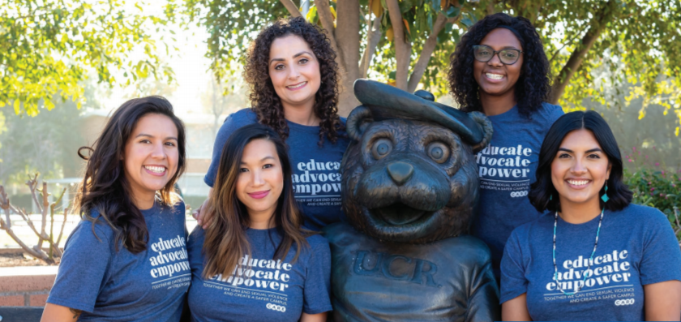
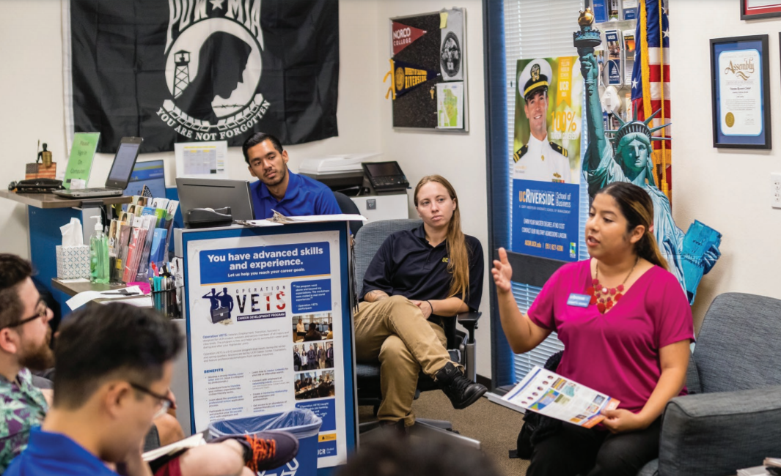
Most Promising Places to Work in Student Affairs 2021 & 2022
The Division of Student Affairs was named one of the top 15 most promising places to work in student affairs by Diverse: Issues in Higher Education and The American College Personnel Association (ACPA).

Slide 12
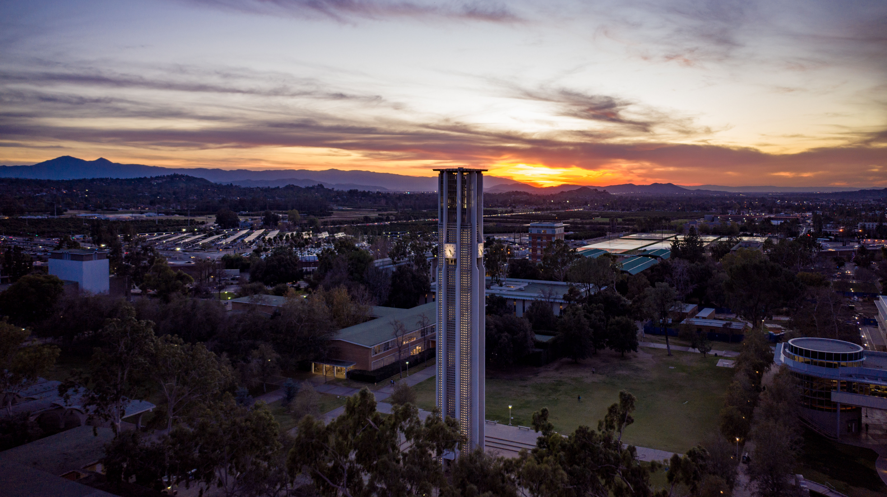
Email: vcsa@ucr.edu
Instagram: ucrstudentaffairs

