Slide 1
Staff Assembly
Spring Meeting
Dr. Brian Haynes
Vice Chancellor for Student Affairs
May 11, 2022

Slide 2

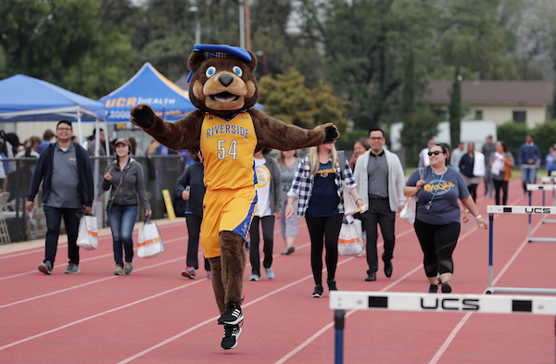
Team Building for the Better
A Team Must Work Together
If everyone is moving forward together, then success takes care of itself.
Henry Ford
If you want to go fast, go alone. If you want to go far, go together.
African Proverb
No one rises to low expectations.
Les Brown
Talent wins games, but teamwork and intelligence wins championships.
Michael Jordan

Slide 3
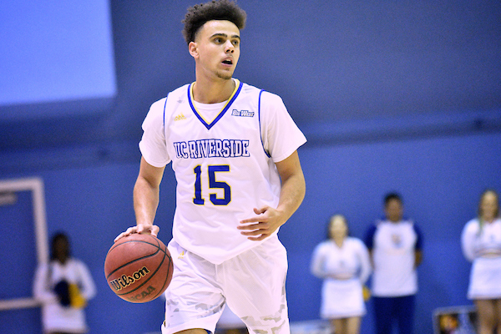
Organizational Updates
Student Affairs Reorganization
Athletics
Intercollegiate Athletics will implement a three-year financial and operational plan to achieve substantial permanent budget reductions, increase externally generated revenue, and move toward financial stability.
Health, Well-Being, & Safety
New division reporting to the Chancellor with dotted line to Student Affairs includes: UCPD, CARE, Basic Needs, and departments previously under Student Health & Wellness Services—Student Health Services, Counseling and Psychological Services, The Well, Student Affairs Case Management, and the Student Disability Resource Center.
Commencement/Convocation
The Division of Student Affairs will be the institutional owner of convocation, commencement, and any other student-facing events that EM&P supports.

Slide 4
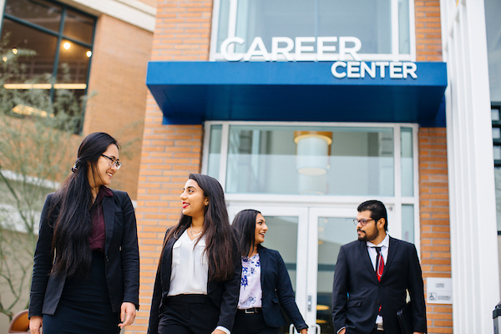
Organizational Updates
Student Affairs Reorganization
Career Center
Joined the Division of Student affairs on January 1, 2022, in addition to the Academic Preparation Programs. This transition will position the Career Center to contribute to and influence the employment experience that ties tightly to the academic and co-curricular experience of both the undergraduate and graduate student community
Academic Preparation Programs
This includes the Early Academic Outreach Program, TRIO Programs, and the University Eastside Community Collaborative. Additionally, as Student Affairs continues to strengthen and develop community-based partnerships, the addition of the units within the Academic Preparation Program portfolio will support this vision.

Slide 5
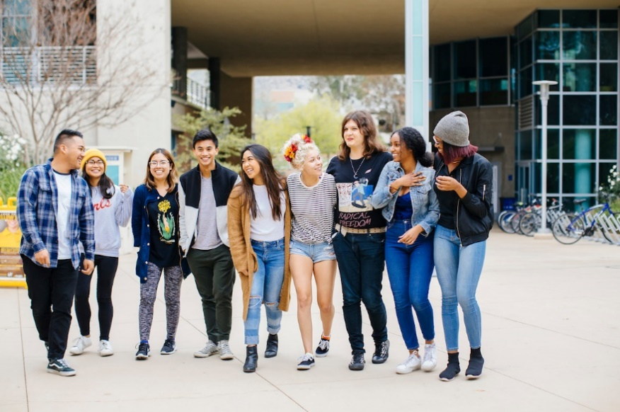
Division of Student Affairs
Vision Statement:
Student Affairs is committed to being a global leader in developing students through innovative, holistic, and transformative best practices to become change agents who inspire, motivate, and create a better world.
Mission Statement:
Student Affairs will provide a transformative experience for current and future world-class change agents through innovative and collaborative partnerships.

Slide 6
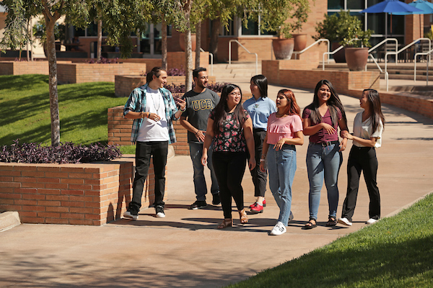
Campus Life
Academic Preparation Programs
Associated Students Program Board (ASPB)
Associated Students (ASUCR)
Athletics (Division I)
Career Center
Dean of Students
Graduate Students Association (GSA)
The Highlander Newspaper
Highlander Union Building (HUB)
KUCR
Residential Life
Student Conduct & Academic Integrity
Student Recreation Center
Student Veteran’s Resource Center

Slide 7
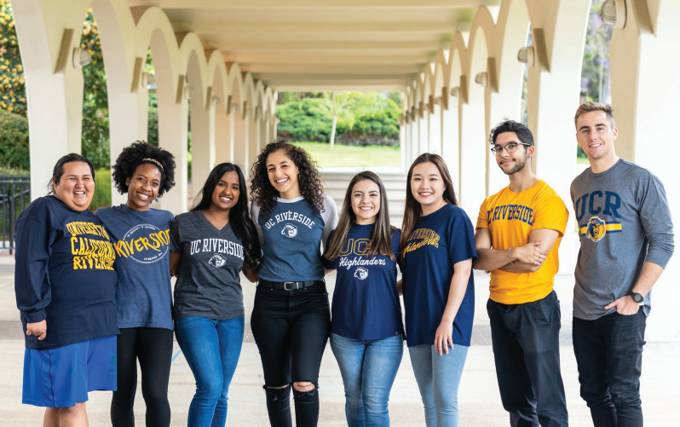
Ethnic & Gender Programs
African Student Programs (ASP)
Asian Pacific Student Programs (APSP)
Chicano Student Programs (CSP)
LGBTQ Resource Center
Middle Eastern Student Center (MESC)
Native American Student Programs (NASP)
The Office of Foster Youth Support Services
Undocumented Student Programs (USP)
Women’s Resource Center (WRC)

Slide 8
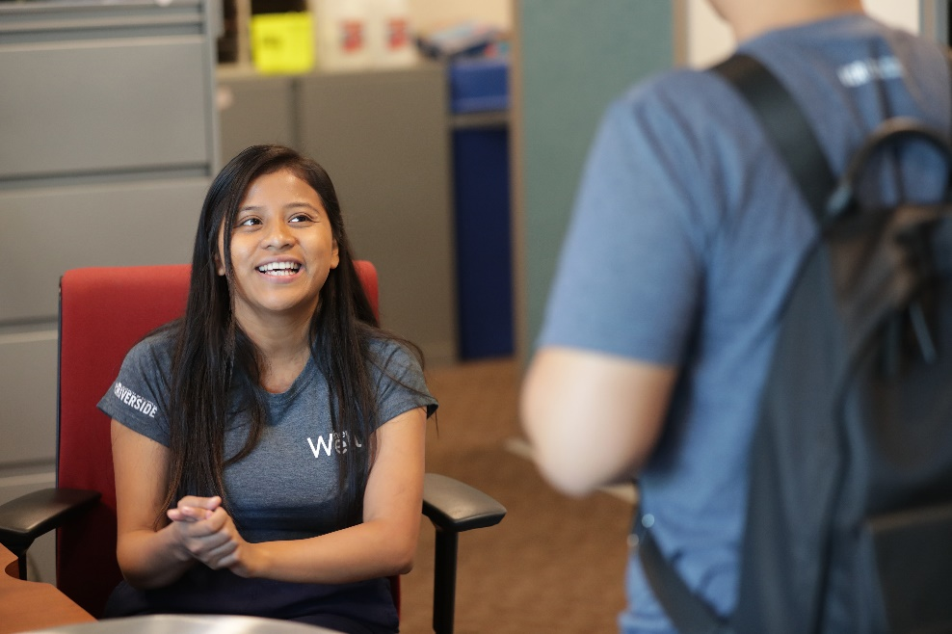
Health, Well-being & Safety
Basic Needs
Campus Advocacy, Resources & Education (CARE)
Counseling & Psychological Services (CAPS)
Student Affairs Case Management
Student Health Services
Student Disability Resource Center
The Well
UCPD

Slide 9
Developing Leaders throughout the Organization
Planning = Dialogue = Success
Monthly Directors’ Meetings: The goal is to meet with the Division’s leadership and share the latest campus updates that impact their programs and students.
Quarterly All-Staff Events: Meet with the Division of Student Affairs to discuss timely and relevant matters as it relates to the campus and its impact on their programs and students.
Bi-weekly Development Discussions: The goal is to build a stronger relationship with our Development colleagues and seek new ways to improve fundraising within the Division of Student Affairs.
Weekly Executive Leadership Meetings: Meet with the Division of Student Affairs executive leadership team to discuss ongoing and timely matters in relation to student success, conduct, and safety and well-being.
Department Meetings: Student Affairs leadership provides updates to their individual units based on the larger team meetings.

Slide 10
2030 Strategic Plan
Division of Student Affairs
Strategic Theme #1: Transform the Student Experience
The Division of Student Affairs will create a transformational experience that promotes students’ overall success, well-being, and resiliency at both the undergraduate and graduate levels.
Strategic Theme #2: Creating Collaborative Partnerships
The Division of Student Affairs will develop campus and community-based collaborative partnerships that foster a student-centered culture of engagement and success.
Strategic Theme #3: Establishing Organizational Excellence
Establish a strong organizational foundation for the division to recruit, hire, and retain a diverse and inclusive team of Student Affairs professionals who will actively contribute to student success.
Strategic Theme #4: Fostering and Advancing Social Justice
To effectively serve an increasingly diverse student body, the Division of Student Affairs will infuse diversity, inclusion, and social justice into every aspect of its work.

Slide 11
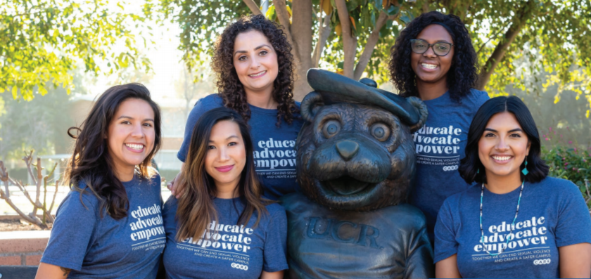
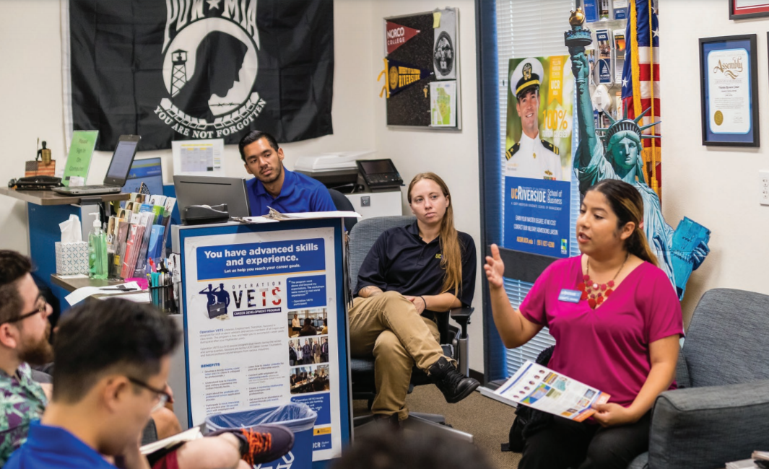
Most Promising Places to Work in Student Affairs 2021 & 2022
The Division of Student Affairs was named one of the top 15 most promising places to work in student affairs by Diverse: Issues in Higher Education and The American College Personnel Association (ACPA).

Slide 12
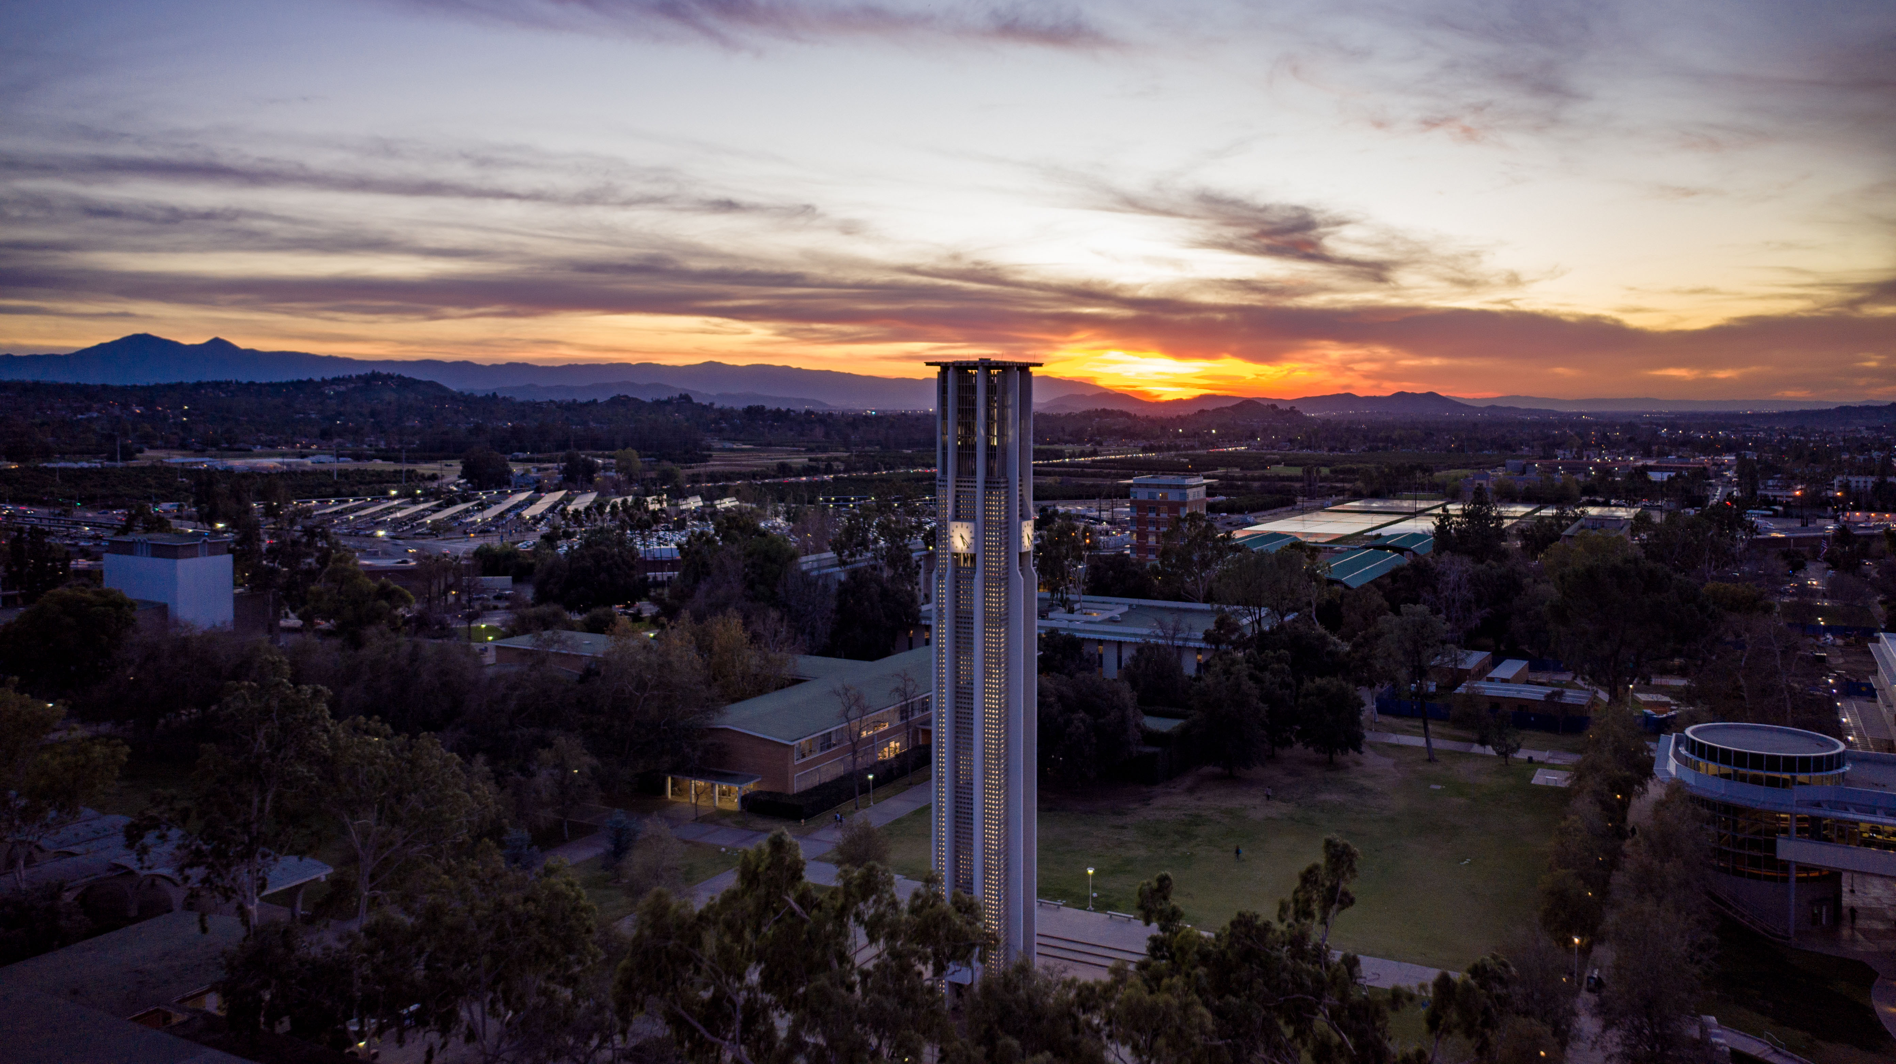
Email: vcsa@ucr.edu
Instagram: ucrstudentaffairs

